Slide 1
API Families
Architecture discussion and API classification
Telefónica SA
Jose Ordonez-Lucena / Juan Carlos García
19/Aug/2021

Slide 2
The document:
presents a proposal for organizing the API families, linking them to the existing Cloud/NaaS reference architectures
introduces a review of the API Families initially proposed
The proposal is for a first discussion previous to introduce it in the GitHub space
Razón social
00.00.2015

Slide 3
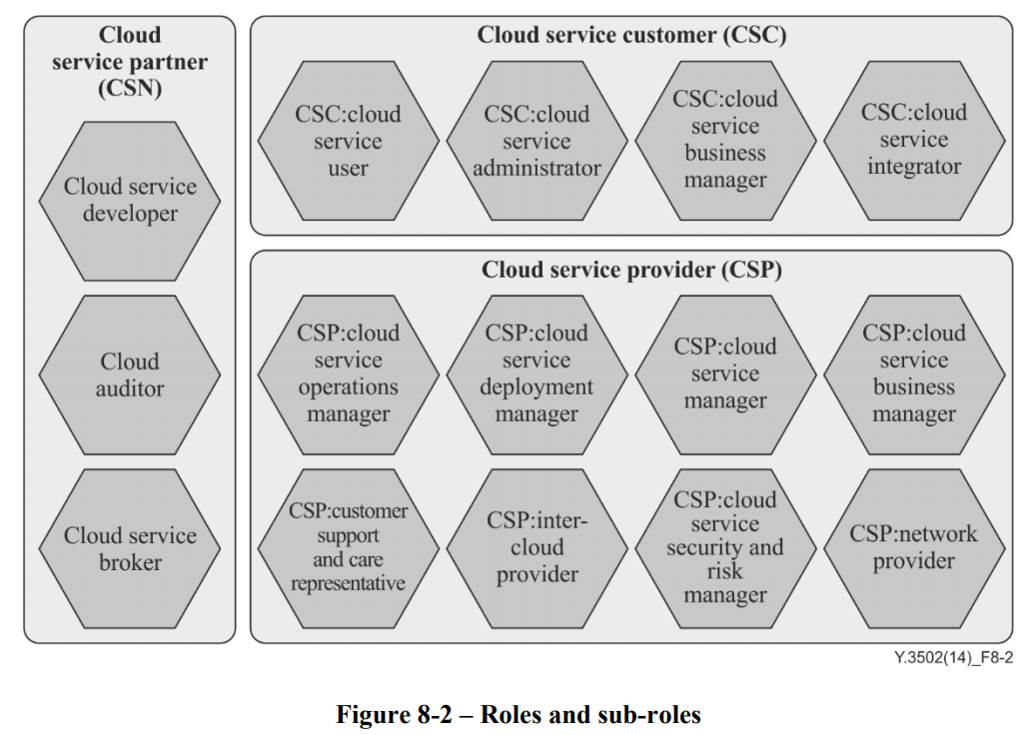
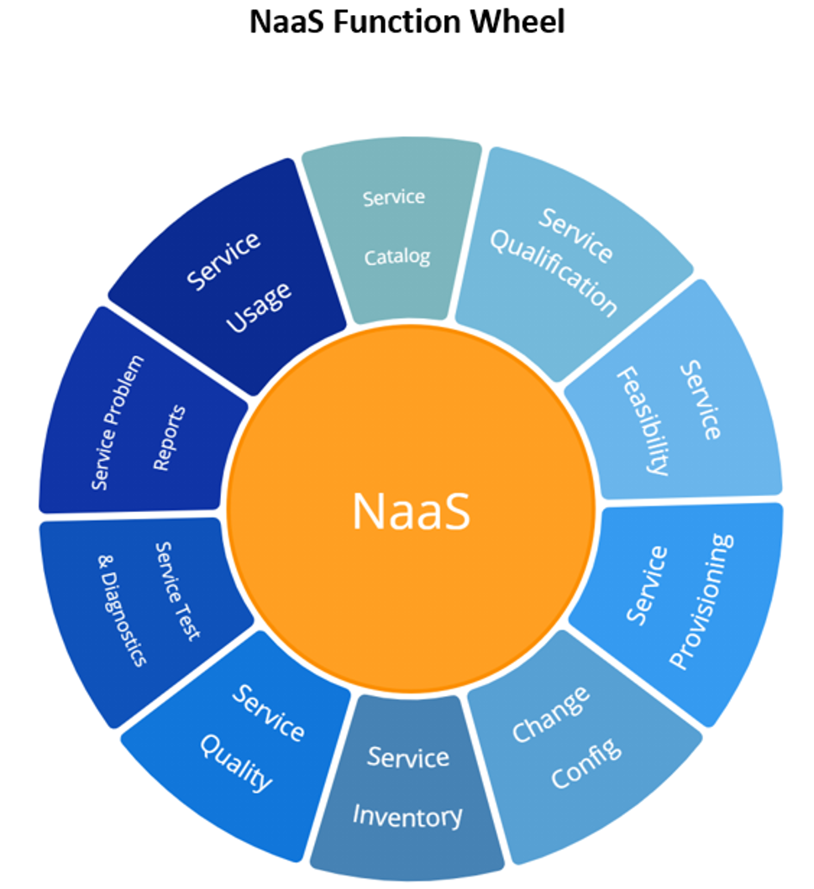
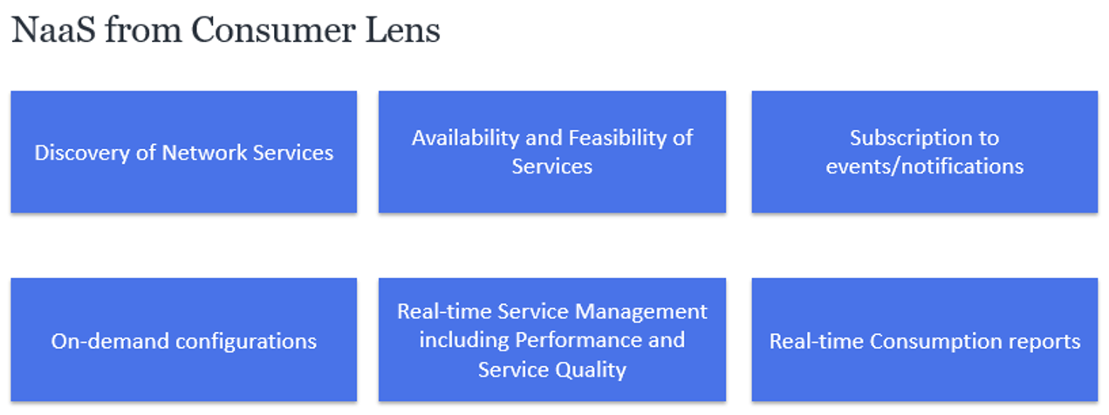
The Reference Architectures
Our understanding is that the APIs are developed to implement NaaS services in the current and future Cloud platforms. For this reason, they should use as reference architectures:
ITU-T Y.3502 Cloud Computing Reference Architecture
ITU-T Y.3515 Cloud Computing – Functional Architecture of Network as a Service
For the management and administration APIs, we consider relevant to use as a reference:
TMF 909 Network as a Service (NaaS) Management REST API Specification. V3.0.1 Nov 2019
IG1224 NaaS Service Fulfillment Guidelines (TM Forum Exploratory Report). March 2021

Slide 4
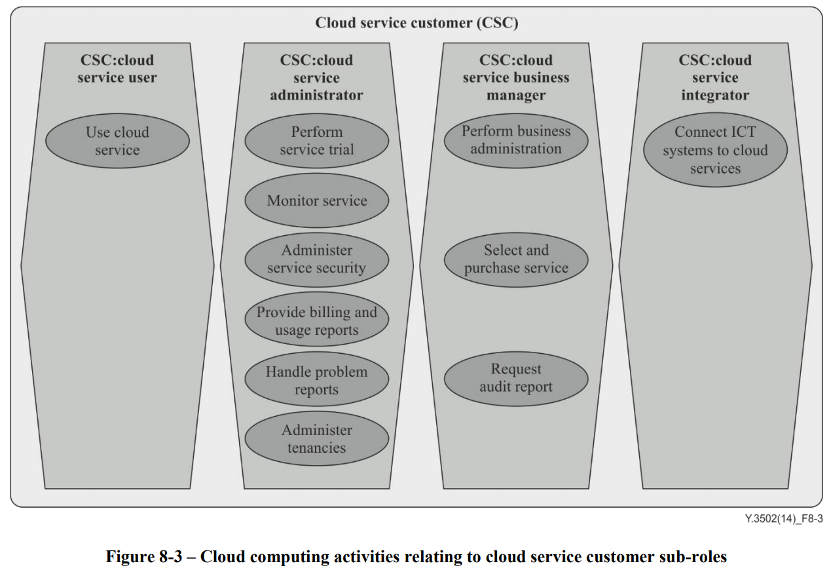
The Reference Architectures: ITU-T
Our understanding is that the Project should not define architectures but use the standard ones already defined for the Cloud and IT Systems (ITU-T and TM Forum) and focus on the design, development and testing aiming at a wide implementation across the industry.
The use of existing reference architectures can facilitate, by reusing, the work of defining API categories and will facilitate the integration of the developed APIs into the existing and future commercial systems/platforms that will implement the defined NaaS services, and its management and administration from the systems of our customers.
The APIs the Project will develop will help our customers (Cloud Service Customers in ITU-T terminology) in the different activities they need to perform as:
User: actual user of the Service
Administrator: management of the Service: monitor, administer Security, billing and usage reports, problem reports, etc.
Business manager: business administration (), select and purchase Service, request Audit report…
Our proposal would be to make a first classification of the APIs in these 3 customer sub-roles.

Slide 5
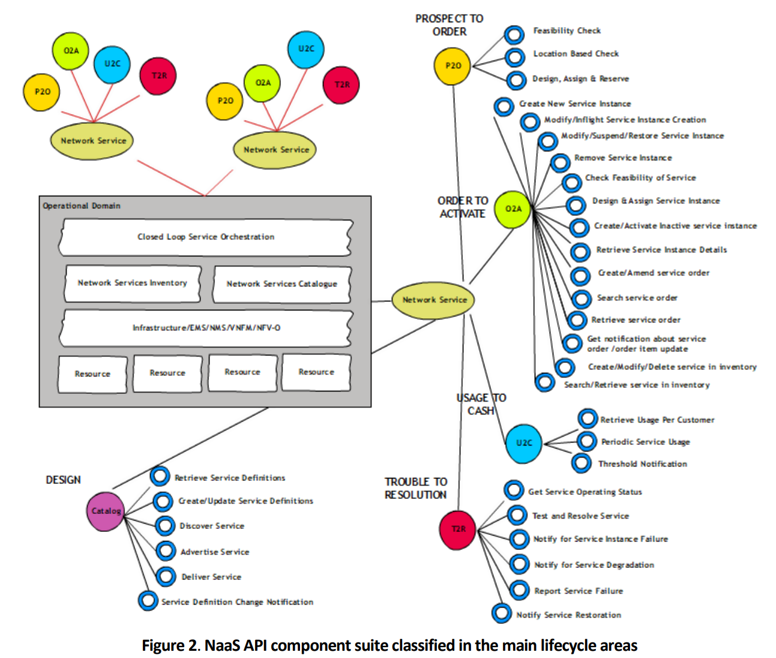
The Reference Architectures: TM Forum
In the case of TM Forum, we could follow its terminology to further categorize the APIs for administration (OAM) and business management following the main lifecycle areas:
P2O: Prospect to Order
O2A: Order to Activate
U2C: Usage to Cash
T2R: Trouble to Resolution
Design
Our proposal would be to make a selection or customization (and simplification) of the APIs defined by TM Forum.
Note: not all the APIs defined by TMForum apply to our case. We have to select or customize the suite of APIs based on the characteristics of our NaaS services

Slide 6
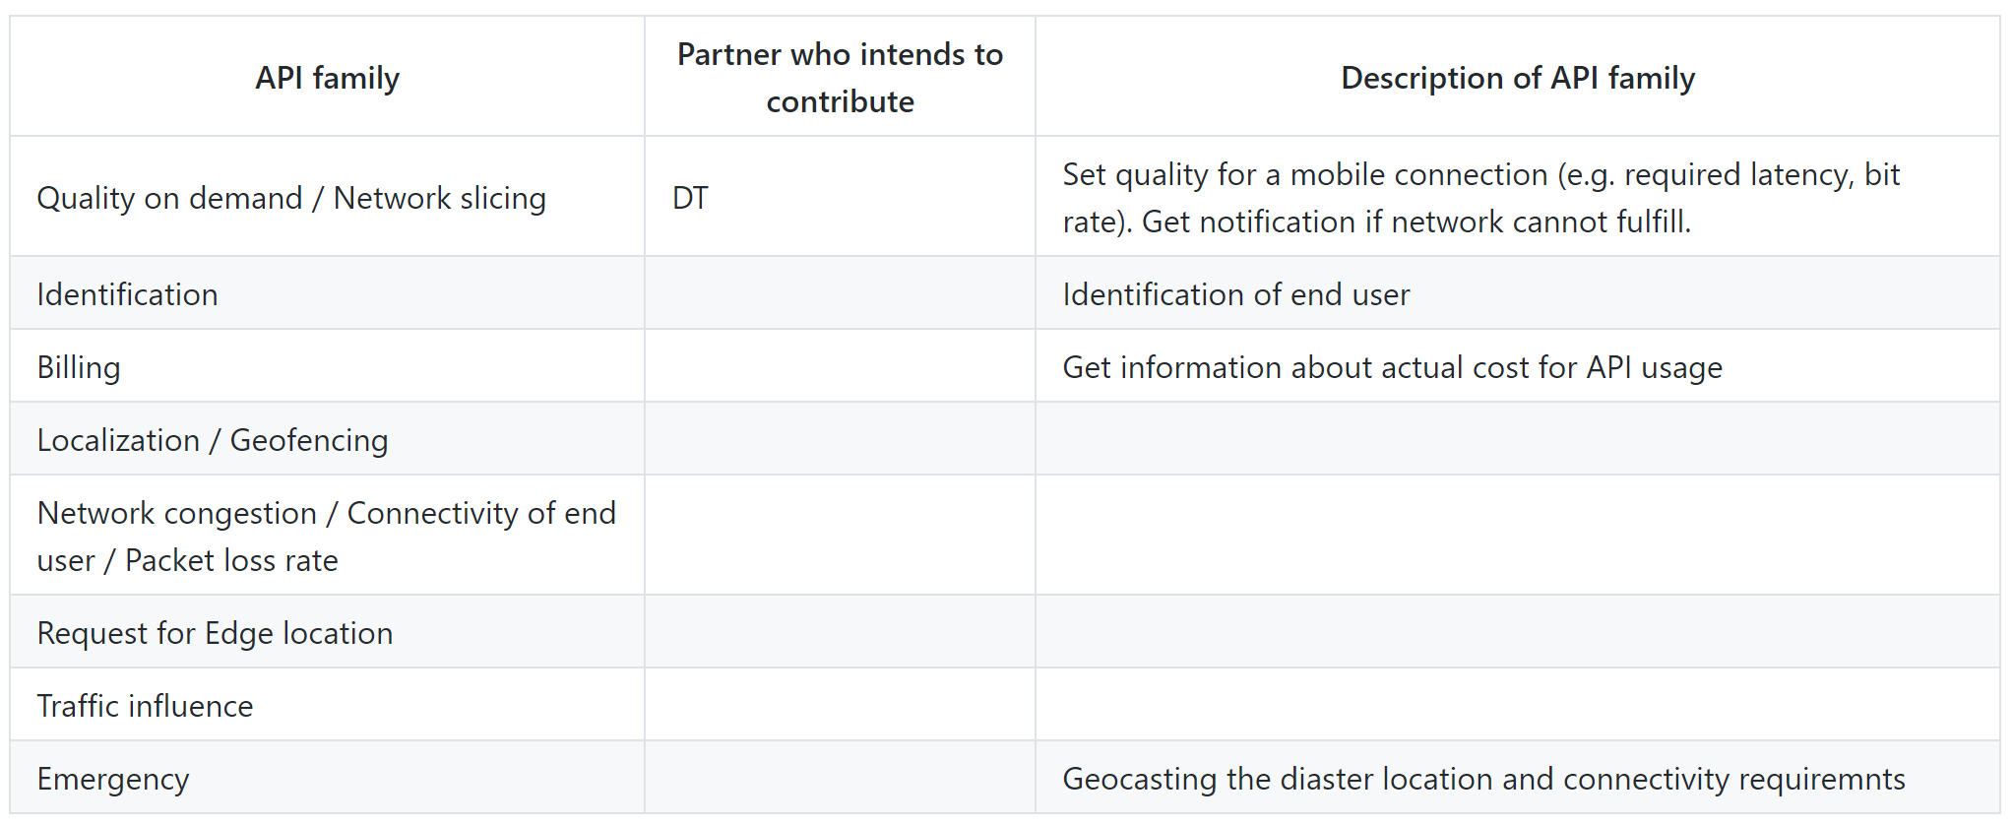
The API Backlog
We use as a reference the API backlog available at the GitHub up to 19/8/21, 12:00 CET
and make in the following pages some suggestions over that version (changes marked in RED)

Slide 7
The API Backlog: Proposal #1
Split Quality on Demand/Network Slicing in two due to their quite different nature and maturity.
Keep network slicing in the initial list for now, but not to make it a top-ranked priority at this stage (lack of technology maturity).

Slide 8
The API Backlog: Proposal #2
Rename “Network congestion/connectivity of end user/packet loss rate” as “Device and Network Status” in order to include other potential retrieval/notification of information about the situation of devices or the Network (see details in description).
NOTE: “Device and Network status” could be further split into two separate API families: “Device status” and ”Network status” (see slides 12, 14, 15).
Include “Identification” in this “Device and Network Status” API family (i.e. remove it from the list):

Slide 9
The API Backlog: Proposal #3
Include “Device configuration”, quite relevant for customers in IoT services/environments

Slide 10
The API Backlog: Proposal #4
Reinforce the set of administration capabilities (OAM) for the Customer:
Extending Billing to “Accounting, Charging and Billing” in order to include accounting (usage of the Service) and charging (activated chargeable components) information in addition to billing (cost of the service).
Adding 2 categories of OAM APIs: baseline and advanced.
In Baseline we include: basic business related data and operation related data needed by the customer to administer the Service. This also includes catalog and inventory for Customer Facing Services (CFS).
Advanced consider policy management and other advanced management capabilities.

Slide 11
The API Backlog: Proposal #5
Description of some of the functional (Service) API Families:
Suggest to rename Request for Edge Location as “Edge Discovery” following the terminology used in “Operator Platform” and other fora like the “5G Future Forum”.
Edge Discovery includes two functions:
Retrieve Edge nodes in a certain region where the Customer can deploy its Edge applications. If the Edge app requires the use of a certain NaaS API, the platform can deliver the nodes where that NaaS API functionality is available.
Retrieve the Edge Service instance(s), i.e. server application instances, that are more convenient for a certain user/device to connect to based on its location and requirements.
An interpretation is given for “Traffic Influence”.
It is not clear for us the functionality provided by the APIs “Localization/geofencing” and “Emergency”

Slide 12
The API Backlog: Proposal #6
Grouping of APIs based on Cloud Reference Architecture and based on the customer activities they support:
Cloud Service Customer
CSC:User
CSC:Administrator
CSC:Business Manager
Quality on Demand
Network Status
Device Status
Edge Discovery/instance
Traffic Influence
Localization/geofencing
Emergency
(Future: Network Slicing)
Accounting (usage), Charging
Operation Related Data
CFS Catalog and Inventory (includes Edge Discovery/nodes)
Advanced OAM
Device configuration
API subscription
Device registration
Other Business Related Data (subscriber data, customer profile, SLAs…)
Billing

Slide 13
The API Backlog: Proposal #7
Grouping of “administration” and “business management” APIs based on TM Forum framework, and based on the customer activities they support (complementary to #5):
CSC:Administrator, CSC:Business Manager
Design
CFS Catalog and Inventory. It includes:
Catalog of APIs
Inventory of Edge nodes where they are available.
Prospect to Order (P2O)
CFS Catalog and Inventory (includes Edge Discovery/nodes)
API subscription
Order to Activate (O2A)
Device registration
Usage to Cash (U2C)
Accounting (usage), Charging and Billing
Other Business Related Data
Trouble to Resolution (T2R)
Operation Related Data
Advanced OAM
Device configuration

Slide 14
The API Backlog: Proposal #8
Not all the APIs have the same priority.
We propose to set up certain criteria for this prioritization based on:
Relevance for the customer. (High/Medium/Low)
Availability of the underlaying Technical capabilities (Short/Medium/Long term)

Slide 15
The API Backlog: Proposal #9
Availability:
We should identify the Technical specifications of the Network capabilities each API relies on so that we can understand the readiness of our current (legacy) and future networks to support them.

